Slide 1
Module 8:Managing Business Process Workflows

Slide 2
Module 8
Managing Business Process Workflows
Leverage out-of-the-box workflows
Create custom workflows with SharePoint Designer
Define conditions, actions, and stages
Capture workflow data with custom forms

Slide 3
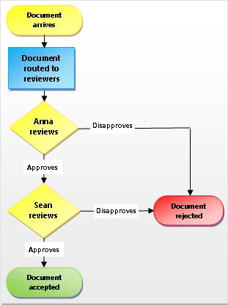
SharePoint Workflow
SharePoint workflows are pre-programmed mini-applications that streamline and automate a wide variety of business processes. Workflows can range from collecting signatures, feedback, or approvals for a plan or document, to tracking the current status of a routine procedure. SharePoint workflows are designed to save you time and effort, and to bring consistency and efficiency to tasks that you perform on a regular basis.

Slide 4
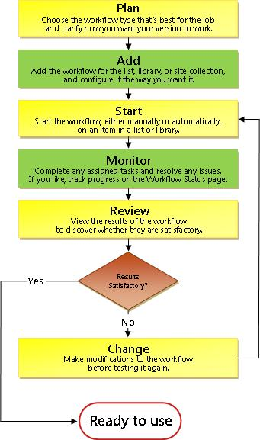
Leverage out-of-the-box workflows
Approval - SharePoint 2010
Collect Feedback - SharePoint 2010
Collect Signature - SharePoint 2010
Three State Workflow
SharePoint publishing approval workflow
Disposition Approval
You must have permission to add SharePoint workflows to a document library or list.
Notes:
SharePoint Designer 2013 is the tool of choice for the rapid development of SharePoint applications. Please make sure your installation of SharePoint Designer is up to date by using Microsoft Update, or installing Service Pack 1

Slide 5
Create custom workflows with SharePoint Designer
List/Library workflow
Reusable Workflow
Site Workflow
Notes:
SharePoint Designer 2013 is the tool of choice for the rapid development of SharePoint applications. Please make sure your installation of SharePoint Designer is up to date by using Microsoft Update, or installing Service Pack 1

Slide 6
Define conditions, actions, and stages
Actions:
Stop Workflow
Capture a Version of the Document Set
Send Document Set to Repository
Set Content Approval Status for the Document Set
Start Document Set Approval Process
Declare Record
Set Content Approval Status
Undeclare Record
Add List Item
Inherit List Item Parent Permissions
Remove List Item Permissions
Replace List Item Permissions
Lookup Manager of a User
Assign a Form to a Group
Assign a To-Do Item
Collect Data from a User
Start Approval Process
Start Custom Task Process
Start Feedback Process
Copy List Item (SharePoint Designer 2013 supports only the document-copying action.)

Slide 7
Define conditions, actions, and stages
Conditions:
If current item field equals value
Check list item permission levels
Check list item permissions

Slide 8
Define conditions, actions, and stages
Conditions:
Steps:
Impersonation Step:
Data sources:
User Profile lookup
Other features:
Visio integration
Association Column
Content Type Association for reusable workflow
'Require Manage List/Web Permission' feature for list/site workflow
Globally reusable workflow type
Workflow visualization option

Slide 9
Capture workflow data with custom forms
- Demo

